Slide 1
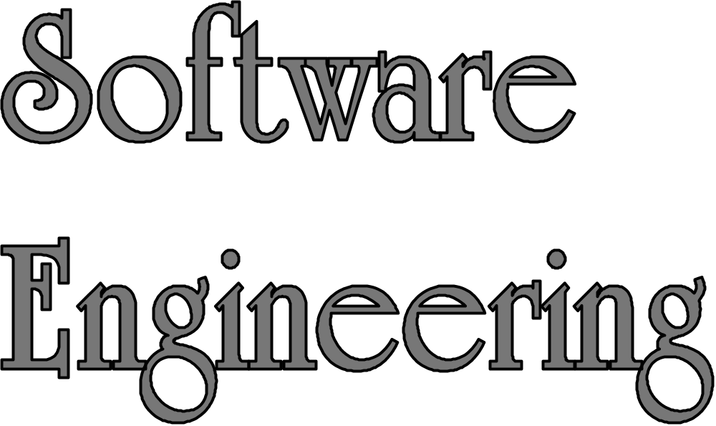
LECTURE 4: Software Architecture
Instructor: Maria Striki
Presentation Slides: Ivan Marsic, Maria Striki
Rutgers University

Slide 2
Topics
Problem Structure vs. Solution Structure
Software Architecture Definition
Architectural Decisions & Key Concerns
Architectural Styles
Documenting Architecture: Views

Slide 3
Hierarchical Organization of Software
Product line (or product family)
highest abstraction level
System or product
Subsystems/Modules
Packages
Classes/Objects
Methods
lowest level
Source code
Software is not one long list of program statements but it has structure
Taxonomy of structural parts (abstraction hierarchy), but not representation of relationships between the parts
and does not specify the function of each part
The hierarchy shows a taxonomy of the system parts, but not the procedure for decomposing the system into parts — how do we do it?
But first, why do we want to decompose systems?

Slide 4
Why We Want To
Decompose Systems
Tackle complexity by “divide-and-conquer”
See if some parts already exist & can be reused
Focus on creative parts and avoid “reinventing the wheel”
Support flexibility and future evolution by decoupling unrelated parts, so each can evolve separately (“separation of concerns”)
Create sustainable strategic advantage

Slide 5
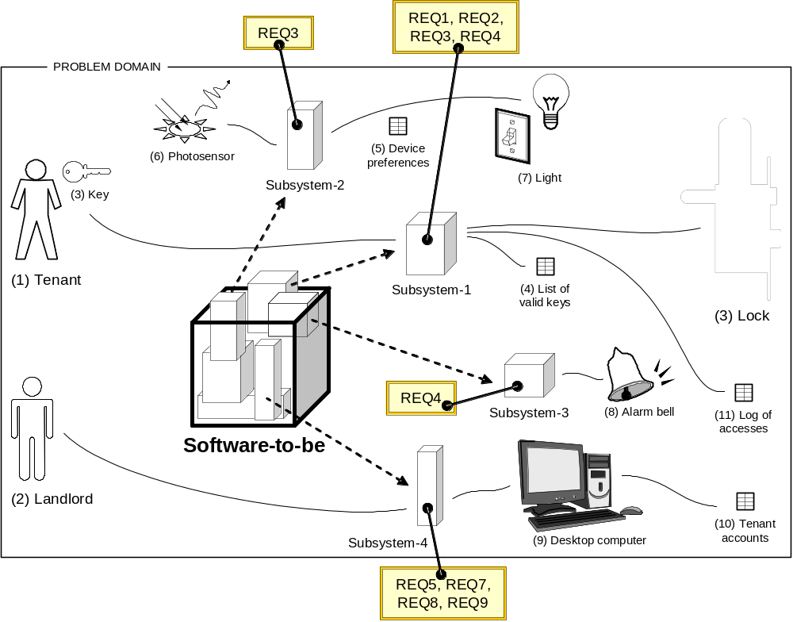
Problem Structure
Subsystems derived from the requirements (“bottom-up” approach or induction)

Slide 6
Typical Software Eng. Problems
1. User works with computer system
(problem domain is “virtual”, not physical)
1.a) System transforms input document to output document
REQ-1: Map input data to output data as said by given rules
IN doc
System
OUT doc
1.b) User edits information stored in a repository
User
System
System
REQ-2: Allow repository editing, where “repository” is a collection of data
Repository
User
2. Computer system controls the (physical) problem domain
(user not involved)
REQ-3: Automatically control a physical object/device
System
Problem domain
3. Computer system intermediates between
the user and the problem domain
3.a) System observes the problem domain and displays information
REQ-5: Monitor and display information about an object
User
System
Problem domain
User
System
Problem domain
3.b) System controls the problem domain as commanded by the user
REQ-4: Interactively control a physical object/device
User
System
Problem domain

Slide 7
Software (i.e., Solution) Architecture
SYSTEM
1.a) Transformation:
Feeding subsystem
Transformation subsystem
Receiving subsystem
SYSTEM
1.b) Simple editing:
Data editor
User
Data repository
SYSTEM
2. Required behavior:
Controlling subsystem
Controlled subsystem
SYSTEM
3.a) Information display:
Monitoring subsystem
Monitored subsystem
Display
SYSTEM
3.b) Commanded behavior:
Controlling subsystem
Controlled subsystem
Operator

Slide 8
Software Architecture Definition
Software Architecture =
a set of high-level decisions that determine the structure of the solution
(parts of system-to-be and their relationships)
  Principal decisions made throughout the development and evolution of a software system
  made early and affect large parts of the system (“design philosophy”) — such decisions are hard to modify later
Decisions to use well-known solutions that are proven to work for similar problems
Software Architecture is not a phase of development
  Does not refer to a specific product of a particular phase of the development process (labeled “high-level design” or “product design”)

Slide 9
Example Architectural Decisions
Example decisions:
Safe Home Access System
Subsystem for device control
Subsystem for administration
Subsystem for remote data access
Decision on system decomposition
On embedded computer
On office desktop
On tenant’s smartphone
Decision on mapping software-to-hardware
Such decisions are made early on,
perhaps while discussing the requirements with the customer
to decide which hardware devices will be used for user interaction and device control

Slide 10
Architectural Decisions
—A matter of scope
product line architecture decisions
product or system architecture decisions
systemic impact
Product line scope
Product/system A scope
Product B scope
Subsystem scope
local impact
Class scope
Given the current level of system scope, a decision is “architectural” if it can be made only by considering the present scope
  I.e. could not be made from a more narrowly-scoped, local perspective
  Architectural decisions should focus on high impact, high priority areas that are in strong alignment with the business strategy
Notes:
Based on: “Introduction to Software Architecture”, by Dana Bredemeyer ( Web: http://www.bredemeyer.com )

Slide 11
Software Architecture
Key Concerns
(Principal decisions to be made)
System decomposition
  how do we break the system up into pieces?
  do we have all the necessary pieces?
  do the pieces fit together?
Cross-cutting concerns
  broad-scoped qualities or properties of the system
  tradeoffs among the qualities
Conceptual integrity

Slide 12
Architecture versus Design
Architecture focuses on non-functional requirements (“cross-cutting concerns”) and decomposition of functional requirements
Design focuses on implementing the functional requirements
  Note: The borders are not always sharp!

Slide 13
Architectural Decisions Often Involve Compromise
The “best” design for a component considered in isolation may not be chosen when components considered together or
within a broader context
Plus, business priorities, available resources, core competences, target customers, competitors’ moves, technology trends, existing investments, backward compatibility, …

Slide 14
Some Well-Known
Architectural Styles
World Wide Web architectural style:
REST (Representational State Transfer)
UNIX shell script architectural style:
Pipe-and-Filter
Client/Server
Central Repository (database)
Layered (or Multi-Tiered)
Peer-to-Peer
Model-View-Controller

Slide 15
Architectural Styles –
Constituent Parts
Components
  Processing elements that “do the work”
Connectors
  Enable communication among components
    Broadcast Bus, Middleware-enabled, implicit (events), explicit (procedure calls, ORBs, explicit communications bus) …
Interfaces
  Connection points on components and connectors
    define where data may flow in and out of the components/connectors
Configurations
  Arrangements of components and connectors that form an architecture

Slide 16
Architectural Style: Pipe-and-Filter
Components: Filters transform input into output
Connectors: Pipe data streams
Example: UNIX shell commands
filter
filter
filter
pipe
pipe
% ls folder-name | grep –v match-string | more

Slide 17
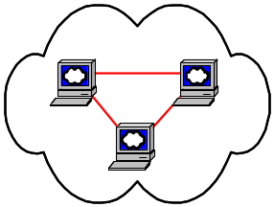
Architectural Style: Layered
a.k.a. Tiered Software Architecture
User Interaction
User Authentication
Archiving
Control of
Sensors and Devices
Communicating alerts
about intrusion
User Interface Layer
Domain Logic Layer
(Business Rules)
Technical Services
Layer

Slide 18
Architectural Style:
Model-View-Controller
Model: holds all the data, state and application logic. Oblivious to the View and Controller. Provides API to retrieve state and send notifications of state changes to “observer”
View: gives user a presentation of the Model.
Gets data directly from the Model
Controller: Takes user input and figures out what it means to the Model
display
View
5. I need your state (to display)
Model
4. I have changed
3. Change your display
1. The user did something
Controller
user
2. Change your state
input device

Slide 19
Model-View-Controller
User Interface
Model
Controller
Input
device
events
Event
Interpreter
Domain
model
action
Domain
Model
Visual feedback
of the altered
model
Model
Visualizer
Notification
about the
effects of the
action
User
View
26
31
14
Model: array of numbers [ 14, 26, 31 ]
➔ Different Views for the same Model:
14
31
versus
26

Slide 20
Real System is a Combination of Styles
Subsystem for device control
Central Repository
Architectural Style
Subsystem for remote data access
Valid keys
Access history
Tenant profiles
…
Subsystem for administration
Application server
Web server
Web browser
Tiered Architectural Style

Slide 21
Fitting the Parts Together
Interface Specification Semantics
  To serve as a contract between component providers and clients, interfaces must be
    fully documented
    semantics, not just syntax
    understandable, unambiguous, precise
Adding semantics
  informal description
  design models (e.g., UML interaction diagrams)
  pre/post conditions

Slide 22
Documenting Software Architecture: Architecture Views
Views are different kinds of “blueprints” created for the system-to-be
    E.g., blueprints for buildings: construction, plumbing, electric wiring , heating, air conditioning, …
    (Different stakeholders have different information needs)
Module/Subsystem Views
Component and Connector Views
Allocation Views

Slide 23
Module/Subsystem Views
Decomposition View
  Top-down refinement (e.g., simple “block diagram”)
Dependency View
  How parts relate to one another
Layered View
  Special case of dependency view
Class View
  “domain model” in OOA and “class diagram” in OOD

Slide 24
Component and Connector Views
Process View
  Defined sequence of activities?
  System represented as a series of communicating processes
Concurrency View
Shared Data View
  …
Client/Server View
  E.g., in Web browsing

Slide 25
Allocation Views
Deployment View
  Software-to-hardware assignment
Implementation View
  File/folder structure – “package diagram”
Work Assignment View
  Work distribution within the development team

